Slide 1
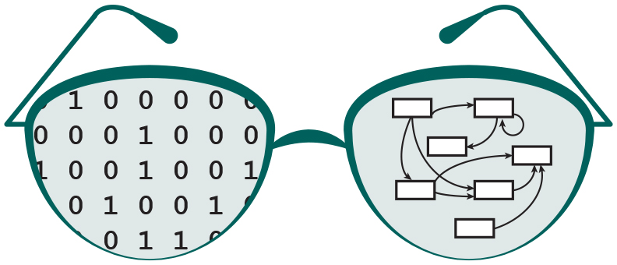

Extending the visualization capabilities of GRNsight: a web application for visualizing models of gene regulatory networks
Eileen J. Choe
Department of Electrical Engineering and Computer Science
Loyola Marymount University
Saturday, March 24, 2018
LMU Undergraduate Research Symposium

Slide 2
Outline
Gene regulatory networks (GRNs) consist of genes, transcription factors, and the regulatory relationships between them.
GRNsight is an open source web application and service for visualizing models of gene regulatory networks.
In GRNsight version 3.0, the Excel spreadsheet controller was redesigned to process data from the entire GRNmap input or output workbook.
In GRNsight version 3.0, a node coloring feature for visualizing gene expression was added.

Slide 3
Outline
Gene regulatory networks (GRNs) consist of genes, transcription factors, and the regulatory relationships between them.
GRNsight is an open source web application and service for visualizing models of gene regulatory networks.
In GRNsight version 3.0, the Excel spreadsheet controller was redesigned to process data from the entire GRNmap input or output workbook.
In GRNsight version 3.0, a node coloring feature for visualizing gene expression was added.
Notes:
- Don’t need to repeat

Slide 4
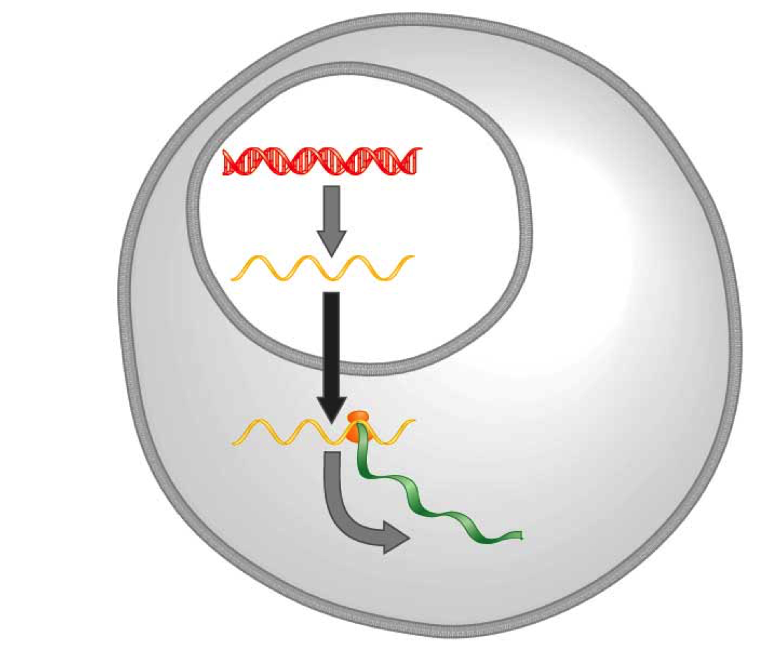
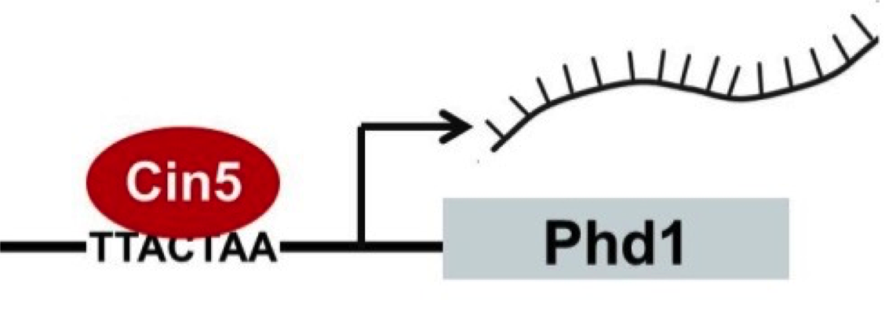
A gene regulatory network (GRN) controls the level of expression of genes and proteins
Transcription factors activate or repress expression.
To understand GRNs we want to quantify the weight values of these regulatory relationships.
DNA
Transcription
mRNA
Translation
Protein
Gene regulatory process
(Freeman, 2002)
Notes:
A GRN’s mechanism of control is transcription factors…

Slide 5
GRNmap models the dynamics of GRNs to estimate weight parameters (w)
Magnitude of weights represent the influence of the transcription factor on its target gene.
Positive weights = activation of gene expression.
Negative weights = repression of gene expression.
GRNsight v3 will take into account other values in the equation.
GRNmap differential equation
Notes:
Initially GRNsight only took the weight value.
I’ll later talk about how we’ve allowed GRNsight to take into account the other values in the other parts of the equation.

Slide 6
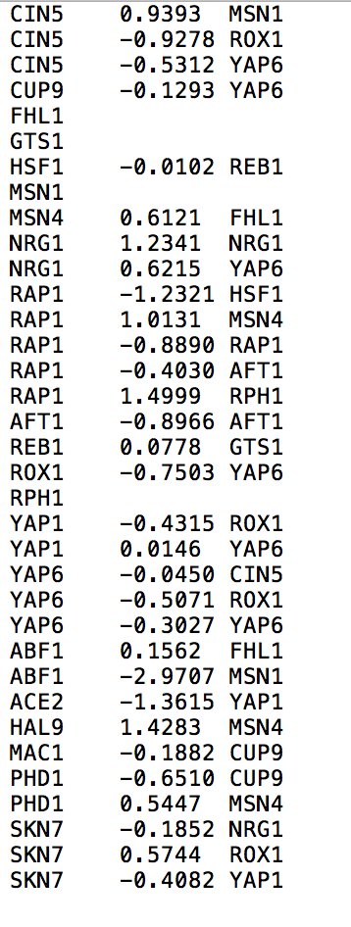
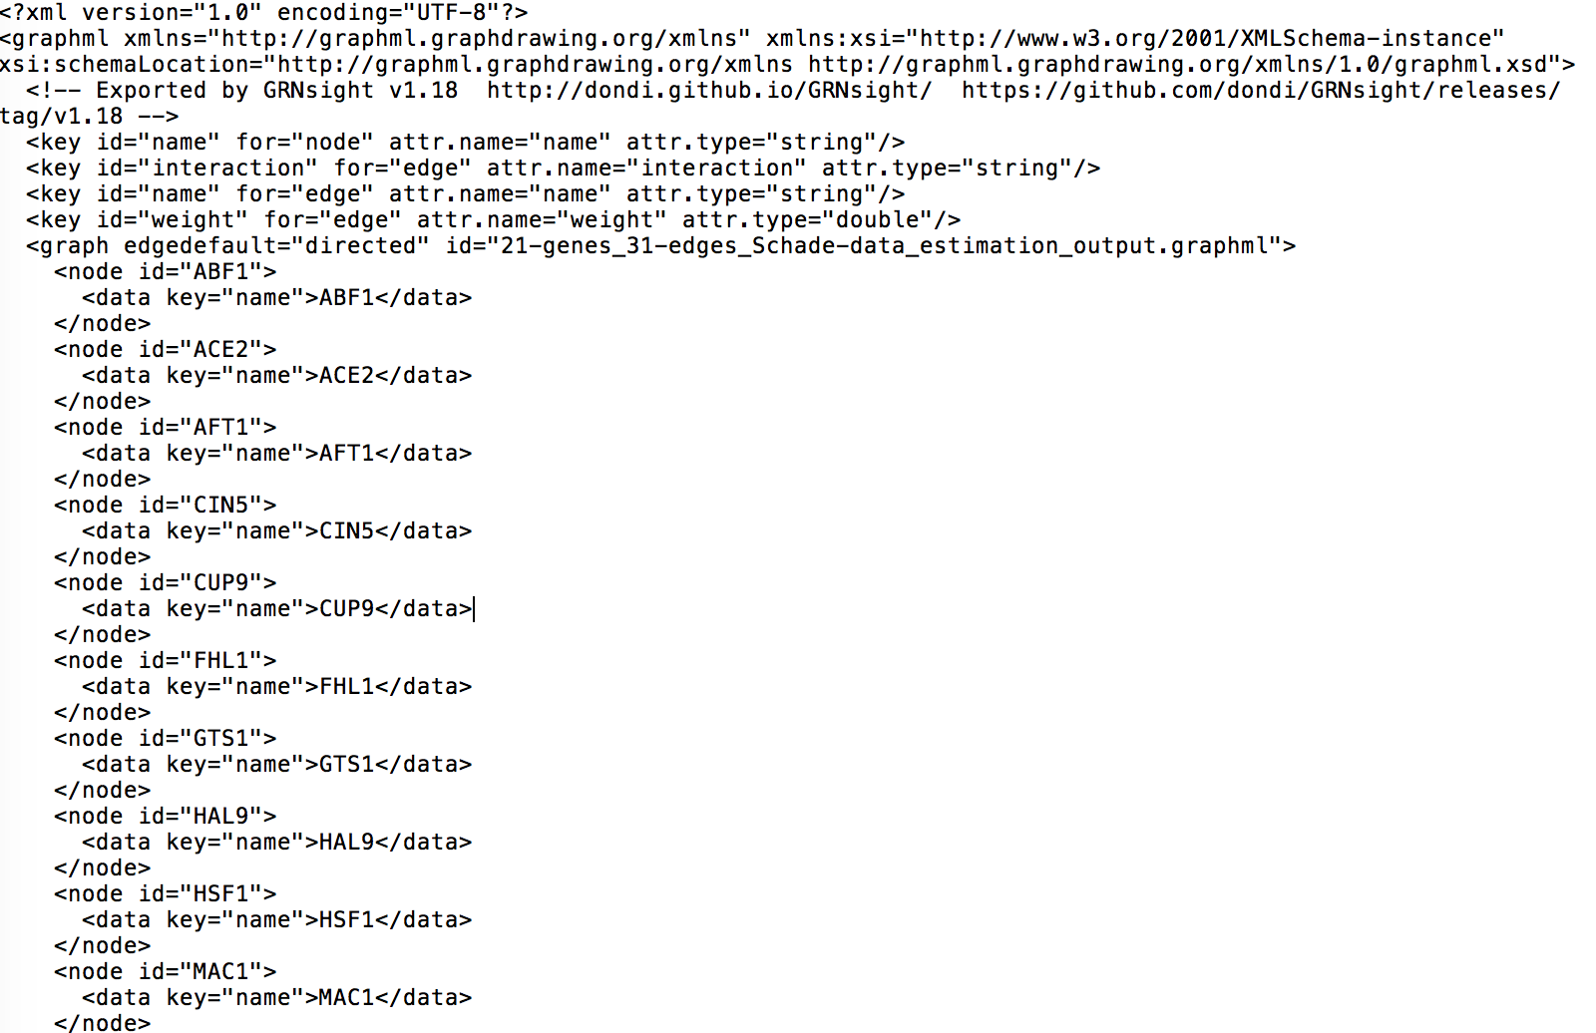
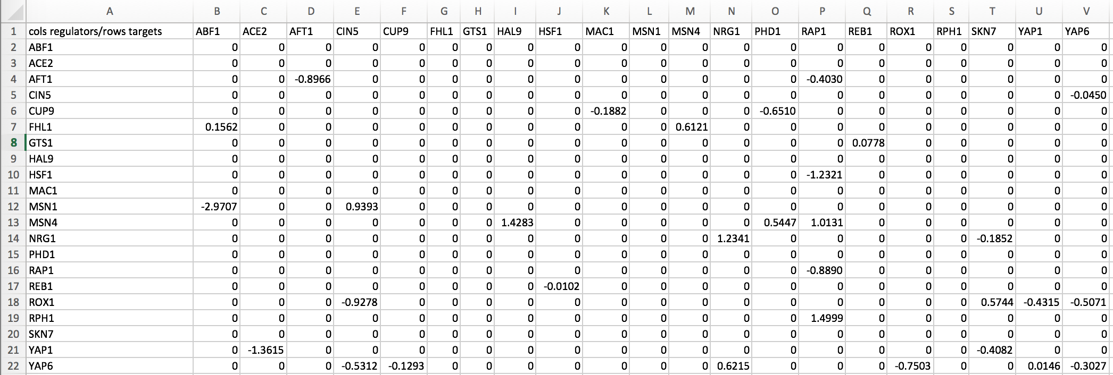
GRNmap outputs Excel spreadsheets, with estimated weight parameters
.xlsx
.graphml
.sif
21 gene, 31 edge weighted network output from GRNmap
Notes:
But it can also be represented in these other two file format (layer on the .sif and .graphml screenshots)

Slide 7
Outline
Gene regulatory networks (GRNs) consist of genes, transcription factors, and the regulatory relationships between them.
GRNsight is an open source web application and service for visualizing models of gene regulatory networks.
In GRNsight version 3.0, the Excel spreadsheet controller was redesigned to process data from the entire GRNmap input or output workbook.
In GRNsight version 3.0, a node coloring feature for visualizing gene expression was added.

Slide 8
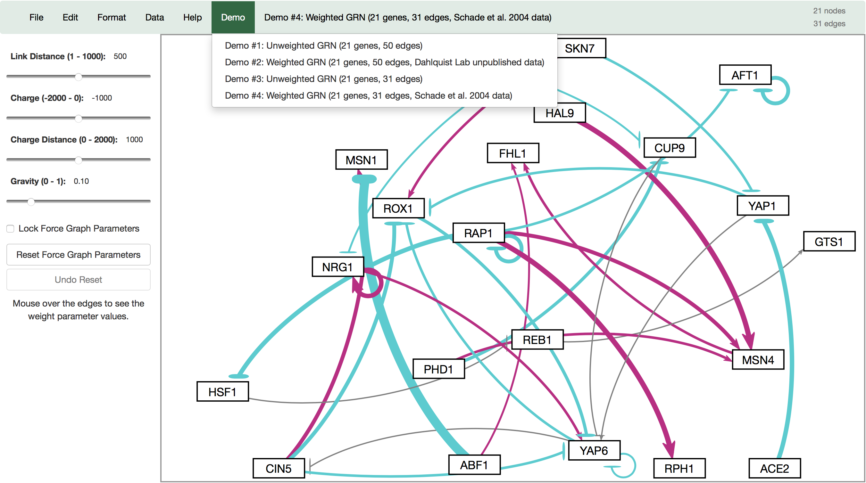
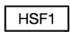
GRNsight automatically produces visualizations of weighted networks from adjacency matrix inputs
Key:
gene
activation
repression
weak influence
Screenshot of GRNsight v1, released Aug 2016
Notes:
Our solution is GRNsight, a web application which automatically produces visualizations of weighted networks from adjacency matrix inputs.
In a GRNsight visualization, rectangular nodes represent genes, and the thickness of arrows represent the strength of regulatory relationships.
The interface on the left panel, allows the user to modify force graph parameters, which apply physics simulation to the graph.

Slide 9
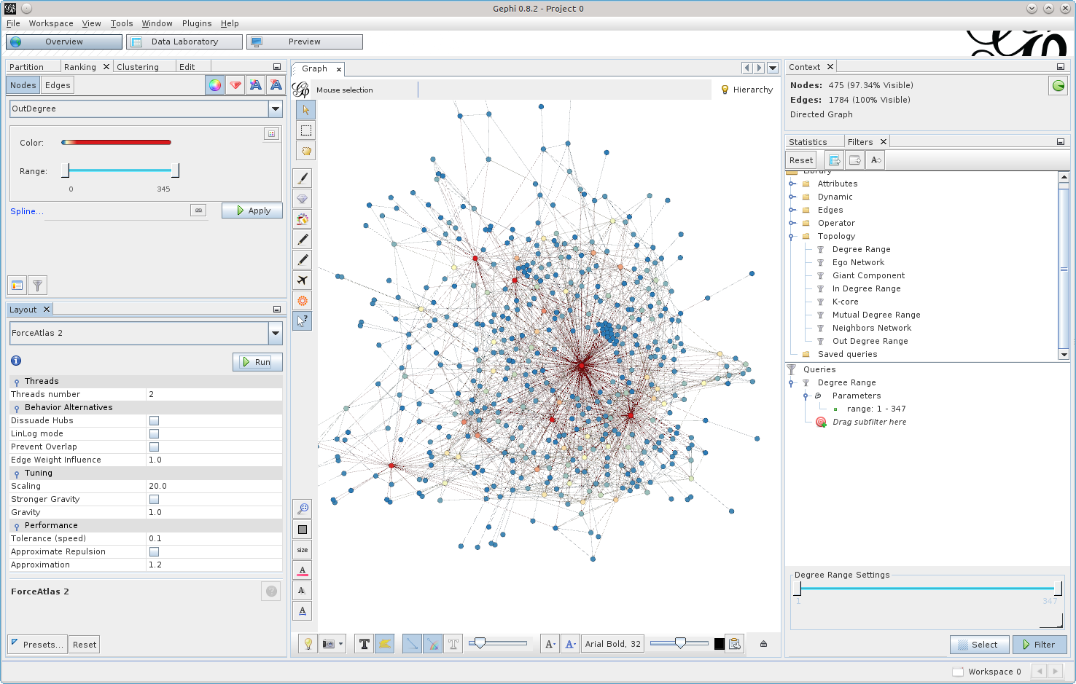
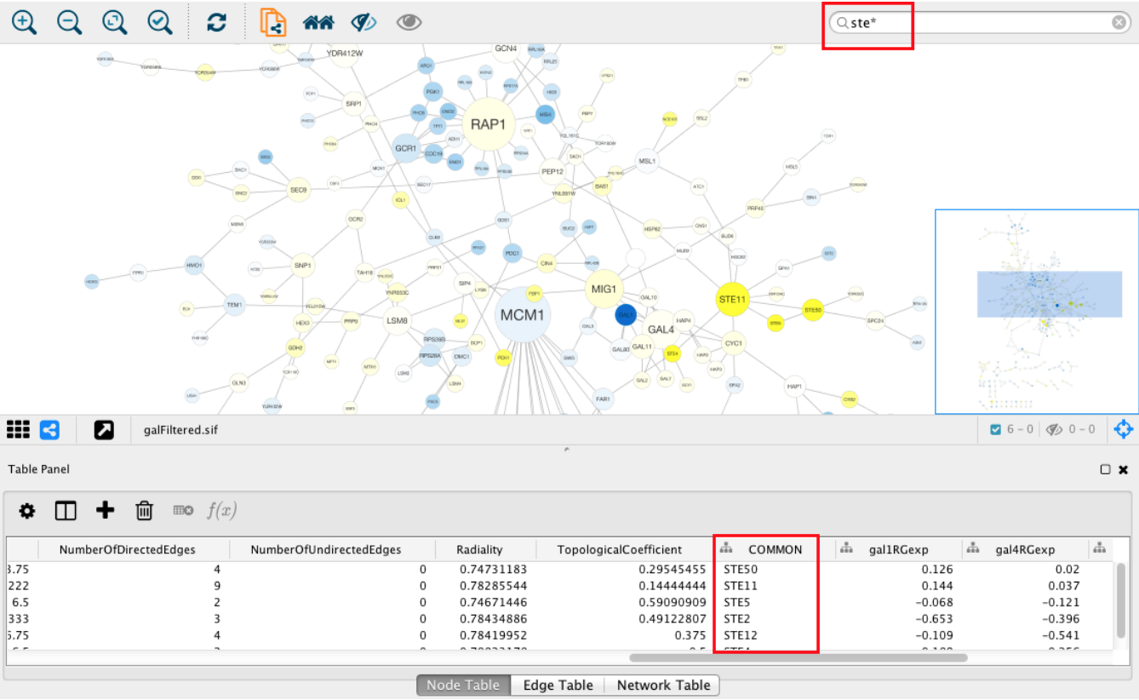
Existing visualization software must be installed and is optimized for large-scale graphs
Cytoscape – cytoscape.org
Gephi - gephi.org

Slide 10
GRNsight fills a niche in bioinformatics visualization software
Cytoscape and Gephi | GRNsight
Optimized for large-scale graphs. | Optimized for small- to medium- scale graphs.
Must be installed. | Exists as a web application.
Several complex features in addition to visualization. | Easy to use, and easily interpretable visualizations.

Slide 11
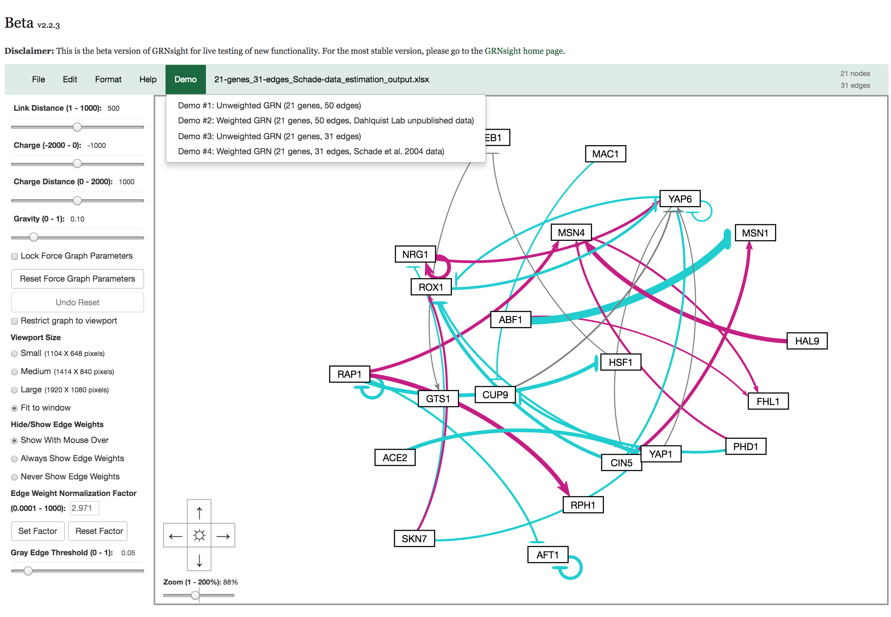
In GRNsight v2, we’ve expanded GRNsight’s visual and analytic feature set
Screenshot of GRNsight v2, released June 2017
Allow users to customize gray edge threshold so that a user can decide the threshold to determining if a relationship is weak.
Allow users to customize normalization factor for edge thickness so that multiple graphs can be generated on the same scale.
Allow users to zoom and scroll within the graph viewport.
Separated bounding box from the viewport to allow graph to reach steady state.

Slide 12
GRNsight v3 is focused on expanding visualization features
What are are alternative ways to visualize weighted networks other than the current force-directed graph?
Grid Layout (Jen Shin, 2018)
What are other data that is provided by GRNmap can GRNsight process and visualize other than the weights?
GRNsight data structure redesign (Eileen Choe, 2018)
Node coloring (Eileen Choe, 2018)

Slide 13
Outline
Gene regulatory networks (GRNs) consist of genes, transcription factors, and the regulatory relationships between them.
GRNsight is an open source web application and service for visualizing models of gene regulatory networks.
In GRNsight version 3.0, the Excel spreadsheet controller was redesigned to process data from the entire GRNmap input or output workbook.
In GRNsight version 3.0, a node coloring feature for visualizing gene expression was added.

Slide 14
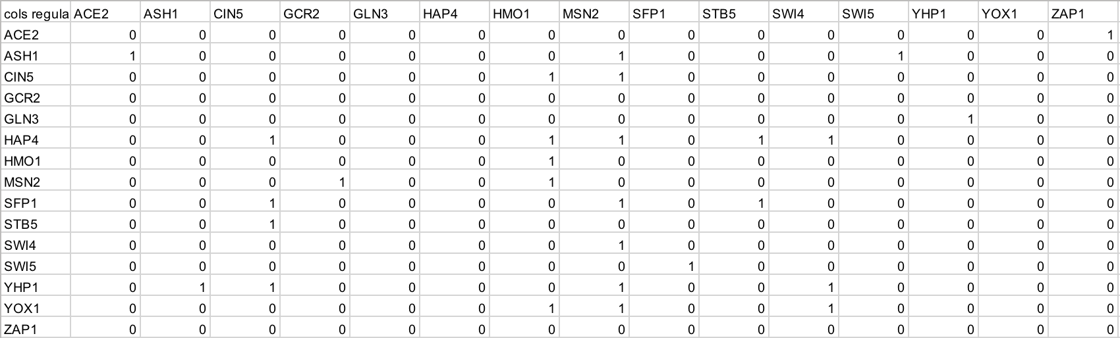
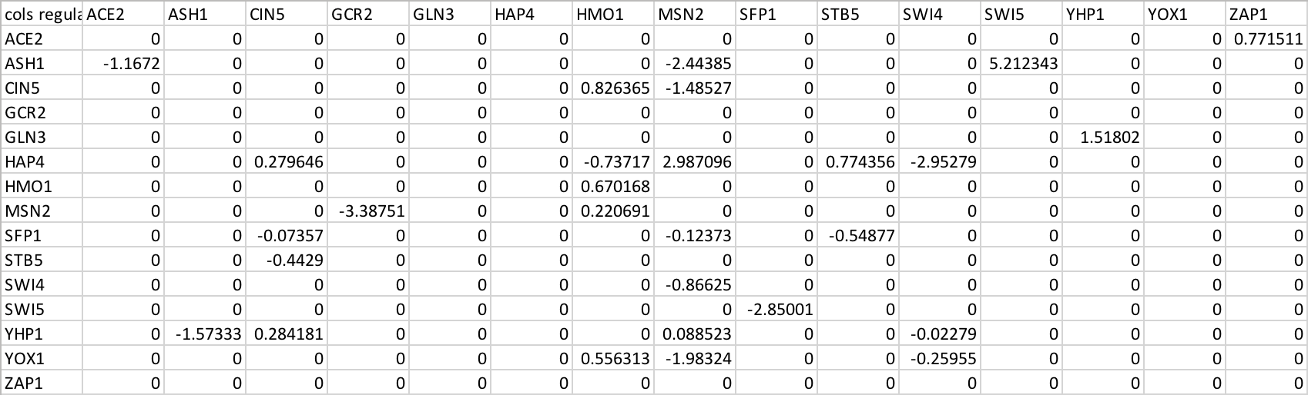
GRNsight was originally designed to process the weight parameters from a GRNmap input or output Excel workbook
Adjacency matrix values correspond to the magnitude of a regulatory relationship from a regulator (column) to a target (row).
Model before GRNmap simulation only has 0s and 1s
Model after GRNmap simulation has estimated weight values

Slide 15
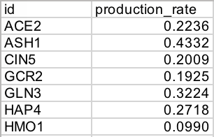
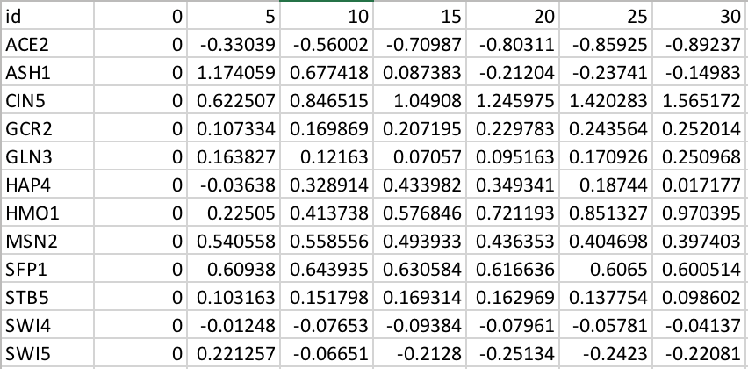
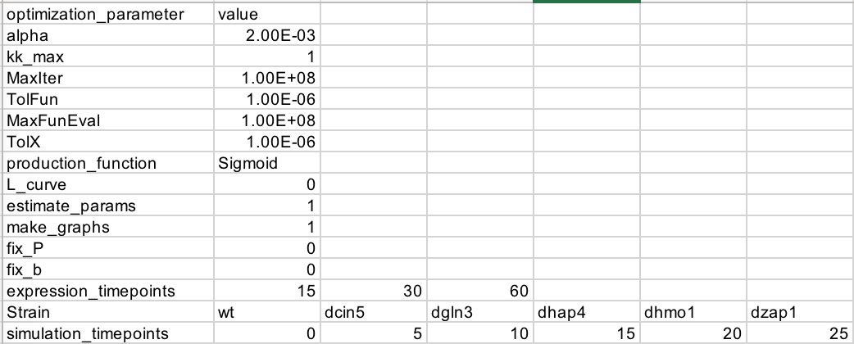
GRNmap workbooks have other worksheets that contain additional data about the GRN
Types of formats of GRNmap Excel sheets:
2-column worksheets
Simple target – value structure for each gene
E.g. “production_rates”, “degradation_rates”
Expression
Time series data
E.g. “wt_log2_expression”, “wt_log2_optimized_espression”
Metadata
Data about GRNmap simulation parameters
E.g. “optimization_parameters”

Slide 16
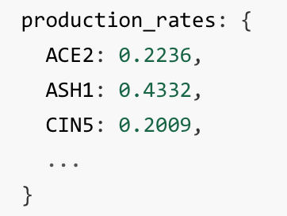
GRNsight’s Excel spreadsheet parser was redesigned to process the entire GRNmap output
Parse, or analyze, the syntax (structure) of data and break it down into logical components
Transform data from Excel spreadsheets into JSON
JSON (JavaScript Object Notation) is a lightweight data format optimal for use in data visualization
Complete internal JSON representation of Excel input is first step towards expanding visualization capabilities of GRNsight

Slide 17
Outline
Gene regulatory networks (GRNs) consist of genes, transcription factors, and the regulatory relationships between them.
GRNsight is an open source web application and service for visualizing models of gene regulatory networks.
In GRNsight version 3.0, the Excel spreadsheet controller was redesigned to process data from the entire GRNmap input or output workbook.
In GRNsight version 3.0, a node coloring feature for visualizing gene expression was added.

Slide 18
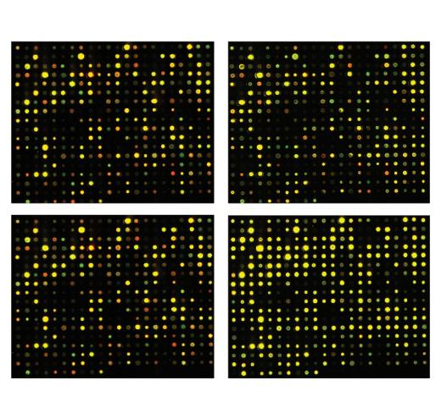
Node coloring feature was developed to visualize gene expression data
t₃₀/t₀ cold shock
t₆₀/t₀ cold shock
Data collected from microarray experiments
Capture gene expression levels at specified time points
t₉₀/t₀ recovery
t₁₂₀/t₀ recovery
Notes:
// TODO: panel of microarray with timepoints with screenshot with excel
// simulated data by solving the differential equation

Slide 19
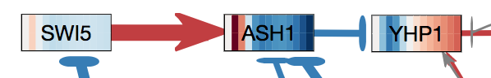
Nodes are colored with a heat map corresponding to gene expression levels over time
Rectangular nodes vertically subdivided by the number of data time points in dataset
The color of each vertical “slice” corresponds to the expression value of that gene at the particular time point
Red = increase in mRNA
Blue = decrease in mRNA
Notes:
Red and blue arrows = activation or repression (verb)
Stripes = increase or decrease in mRNA (noun)
Original color scheme chosen was not color blind friendly
Also wanted the nodes and edges colors to be consistent with each other

Slide 20
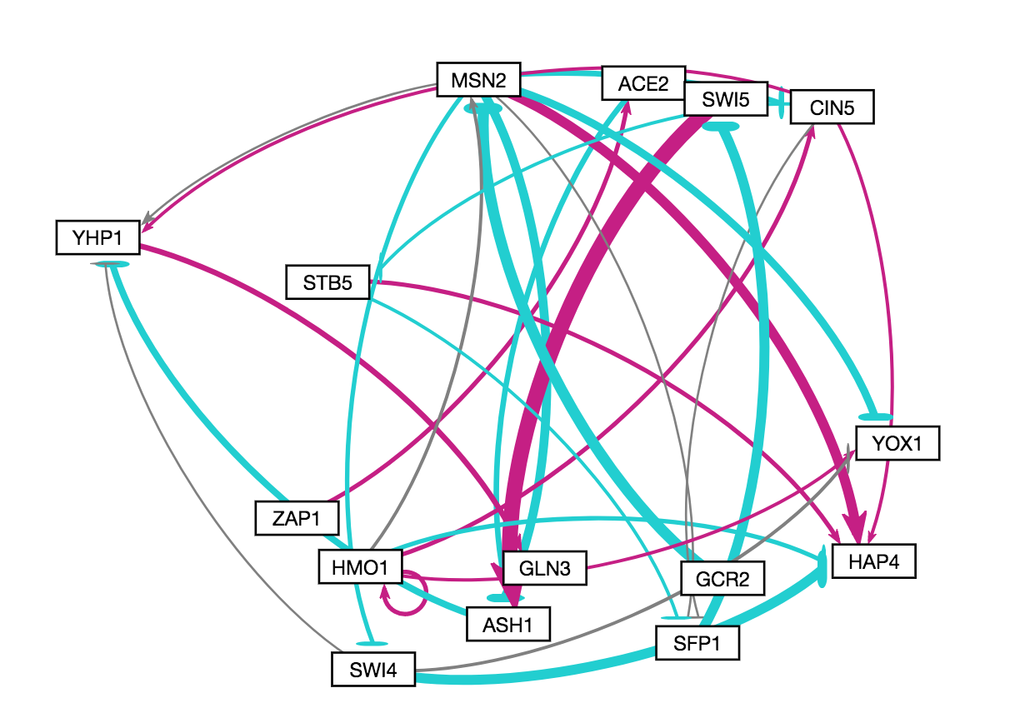
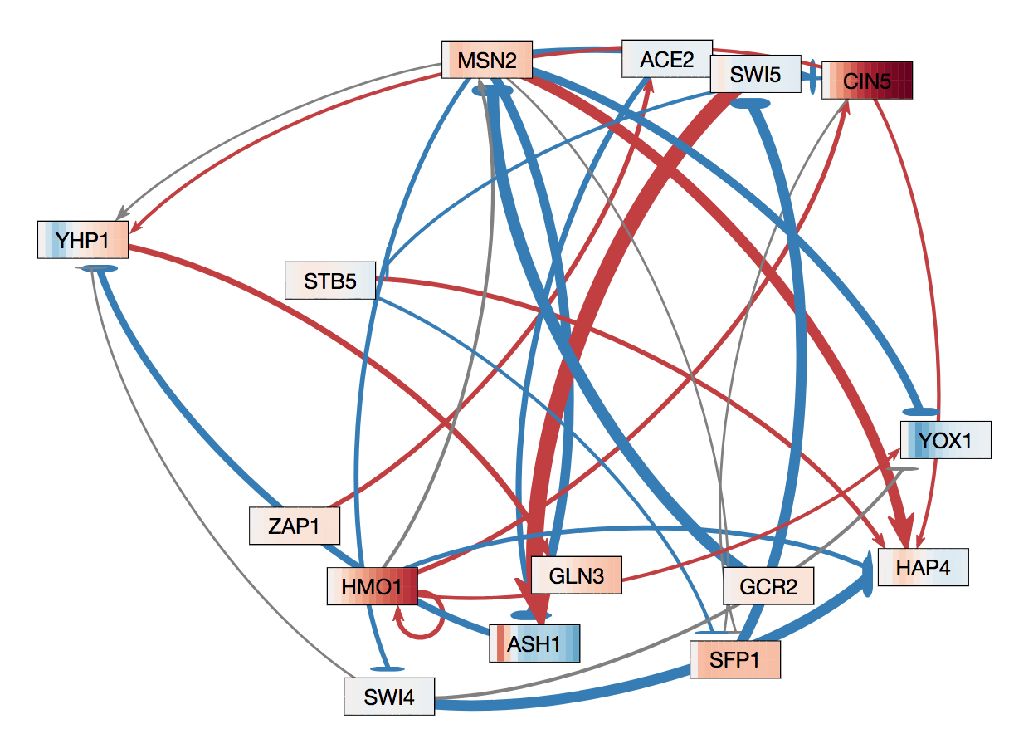
Network edge colors were changed from cyan/magenta to blue/red
Accessibility for color blind users
Consistency for node and edge color schemes
GRNsight v2
GRNsight v3

Slide 21
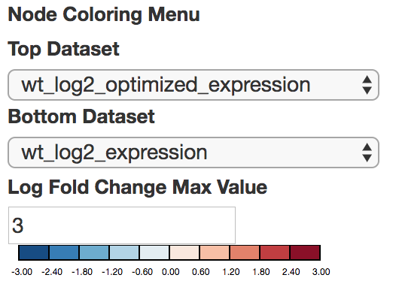
A node coloring menu allows users to modify parameters of node coloring

Slide 22
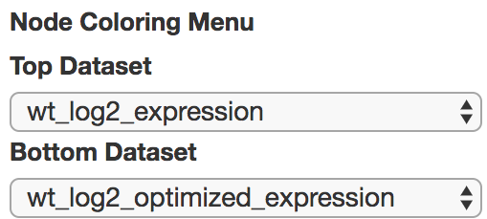
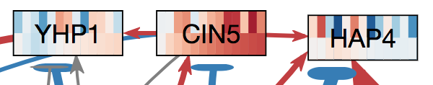
Users can manually select the dataset(s) to use for node coloring
Options are auto generated by automatically detecting the expression sheets in the Excel workbook
Two different datasets can be selected to visually compare expression data
wt_log2_expression
wt_log2_optimized_expression
Notes:
Comparing on the top the experimental data, bottom is simulated data. This tells you how good of a match between experimental and simulated data. Good match for CIN5 and not such a good match for HAP4.

Slide 23
Users may override the default log fold change max value
Log fold change max value determines how expression values “map” to the coloring legend
Default value arbitrarily set to 3

Slide 24
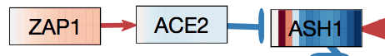
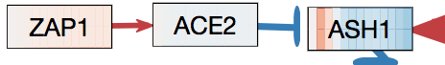
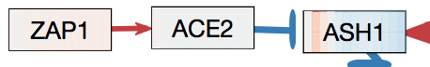
Users may change value to increase/decrease color intensity of their visualization
Log Fold Change Max Value
1
3
5

Slide 25
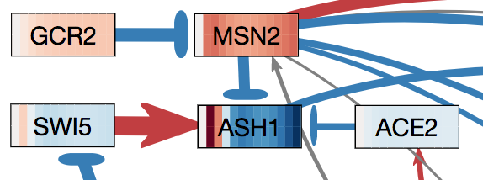
Visual inspection of gene expression is crucial to verifying the correctness of the GRNmap simulation
 | Red | Blue
Edges | Gene Activation | Gene Repression
Nodes | Increase in mRNA | Decrease in mRNA
Snippet of wt_log2_expression visualization
Node coloring of ASH1 is explained by incoming edges
Initially activated by SWI5, then repressed
MSN2 is not explained
Increase in expression, but only regulatory relationship acting on it is a strong repression from GCR2
Another factor missing in the network?
Notes:
SWI increase of expression * arrow causes early activation of ASH1
MSN2
Node coloring of ASH1 is explained by incoming edges
Initially activated bc of massive arrow in SWI5
Later repressed by the other arrows
MSN2 is not explained.
Increasing expression seen through node coloring
Only incoming arrow to MSN2 is strong repression which should cause it to be blue
Whether or not a gene is red or blue is a voting system
Weight * concentration of the gene that is doing the regulating
TODO: look at bulletin of mathematical biology discussion
Red and blue arrows = activation or repression (verb)
Stripes = increase or decrease in mRNA (noun)
SWI5 is strongly repressing ASH1 (red arrow) but node coloring indicates that ASH1’s mRNA levels has decreased not increased.
ACE2, MSN2, and YHP1’s repression on ASH1 is stronger than SWI5’s activation regulatory relationship
There’s another factor which is missing in the network causing decrease in ASH1’s mRNA

Slide 26
Conclusion
Gene regulatory networks (GRNs) consist of genes, transcription factors, and the regulatory relationships between them.
GRNsight is an open source web application and service for visualizing models of gene regulatory networks.
In GRNsight version 3.0, the Excel spreadsheet controller was redesigned to process data from the entire GRNmap input or output workbook.
In GRNsight version 3.0, a node coloring feature for visualizing gene expression was added.
Notes:
In this talk, I’ve introduced you to the concept of gene regulatory networks, which consist of genes, transcription factors, and the regulatory relationships between them. We’ve developed GRNsight which is open source software which allows biologists to understand GRNs through visualization. Building from GRNsight v1, we’ve improved the visual and analytic features (three of which were highlighted in this talk), as well as expanded the client and server side tests.

Slide 27
GRNsight application and code are available under the open source BSD license
http://dondi.github.io/GRNsight/
https://github.com/dondi/GRNsight
Current and future work documented via Github Issues
User interface menu redesign
Additional options for node coloring
User selected color scheme
Animation

Slide 28


Acknowledgements
Loyola Marymount University
Dr. Kam D. Dahlquist
Dr. John David N. Dionisio
GRNsight Team
Mihir Samdarshi
Jen Shin
Eileen Choe
Edward Bachoura
Anindita Varshneya
GRNmap Team
Maggie O’Neil
Brandon Klein
Justin Kyle Torres
John Lopez
Wet Lab Team
Nika Vafadari
Katherine Scheker
Nick Collins

